Slide 1
Data Visualization
Prepared by
Peeradon Parinyasanguan
Wachirawit Jetsiktat
Professor. Min-Te Sun
(WASN Laboratory)
Faculty of Information Communication and Technology
Mahidol University

Slide 2
Agenda
What we have learned
  Data visualization concepts
  R Language
  R Connect
Project
  Introduction
  Dataset
  Live Demo
Future improvement
Summary

Slide 3
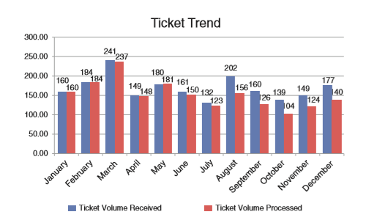
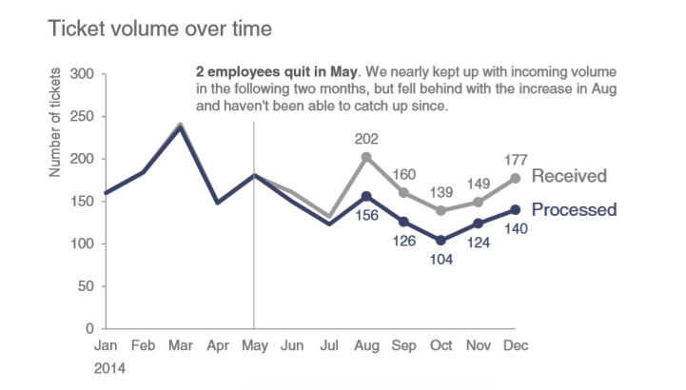
Data Visualization
Tell a story by using data
There are many good and clear data that be used in wrong way to visualize it
Example of bad graph (Left figure) and good graph (Right figure) that show to approve the hire of 2 full time employees
The concept of data visualization is to communicate something to someone clearly and effectively using data

Slide 4
Story telling with Data
There are five points that will make the data tell a story better
  The important of context : Learn about audience and what they need to know
  Choosing an effective visual : How to choose type of text, chart and etc to be appropriate with data
  Clutter is enemy : Remove unnecessarily element that will taking up audience brain power
  Focus audience’s attention : Examine how people see and how to use that as advantage when design a visualization
  Think like a designer : How traditional design concepts can be applied to communicating with data

Slide 5
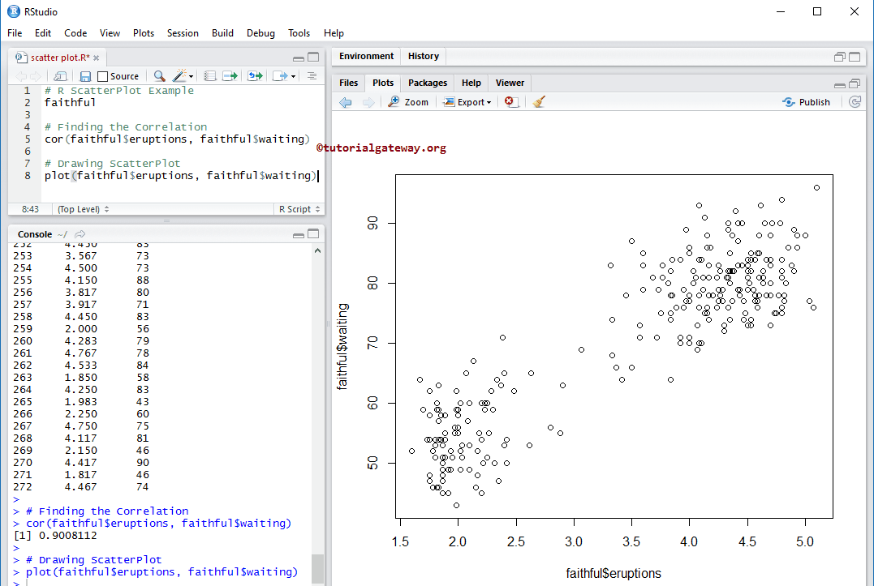
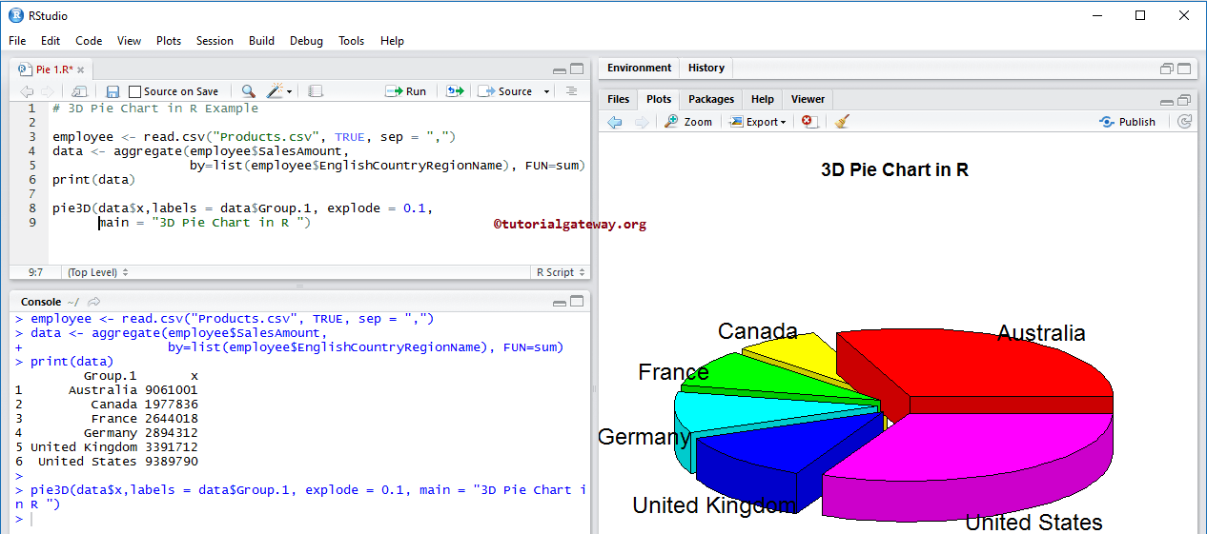
R Language
Easy to use and understandable language
Statistic computing
Ready-to-use plot, chart, map and etc.

Slide 6
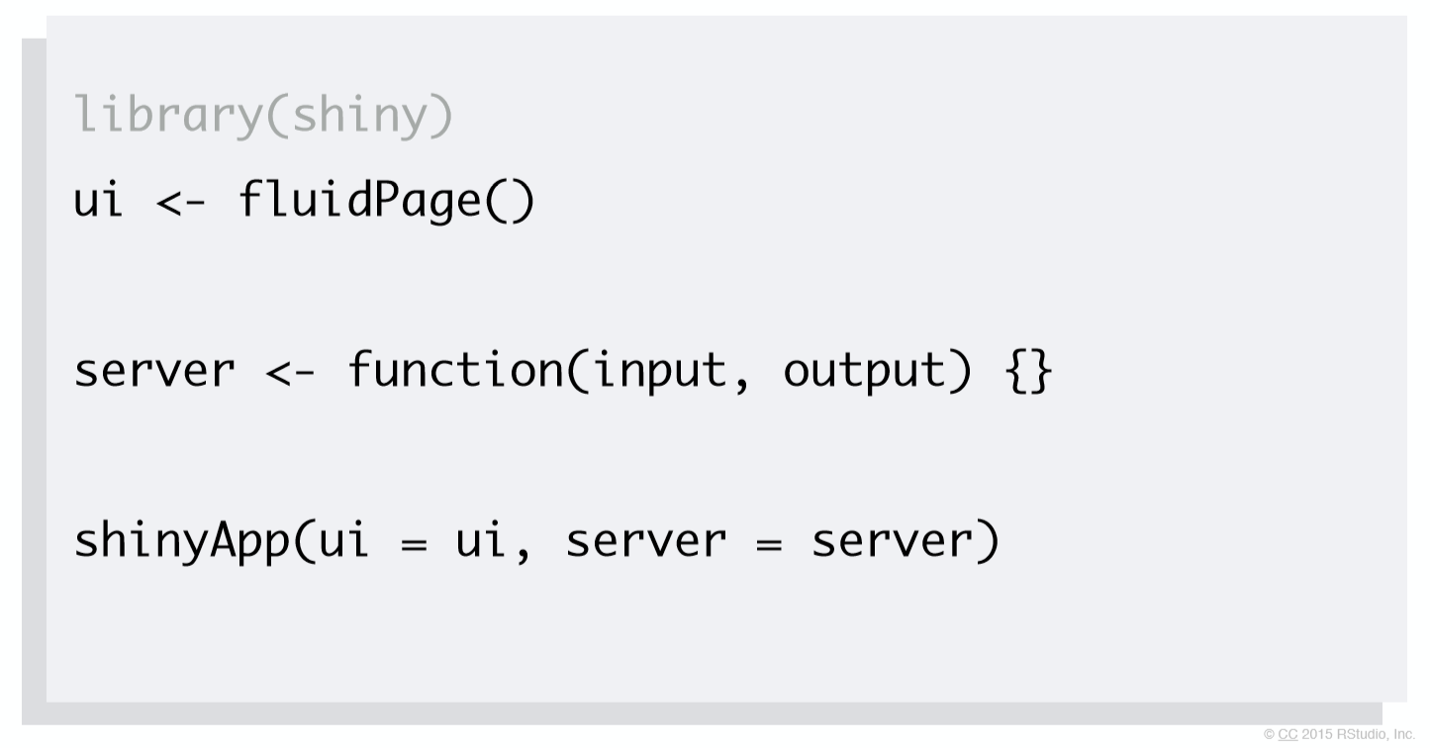
R Shiny / R Connect
Seperate R into 2 parts
  User interface : User sees and interacts with it
  Server : Receive input from UI to create action and send back to UI (if...else, loop and etc.)
Can be uploaded and published on website by using shinyapp.io

Slide 7
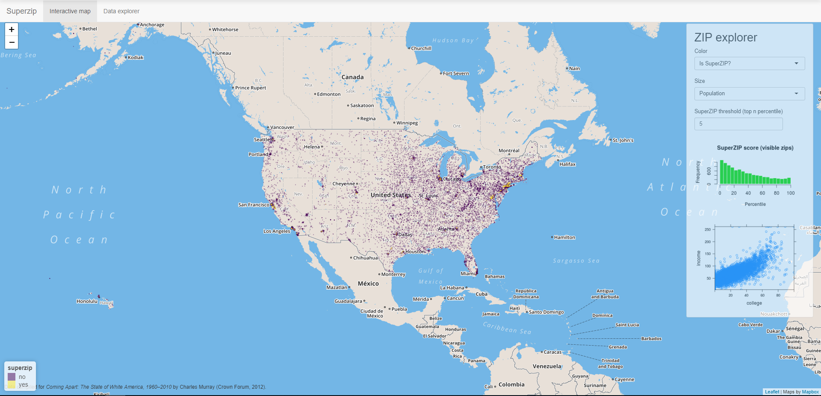
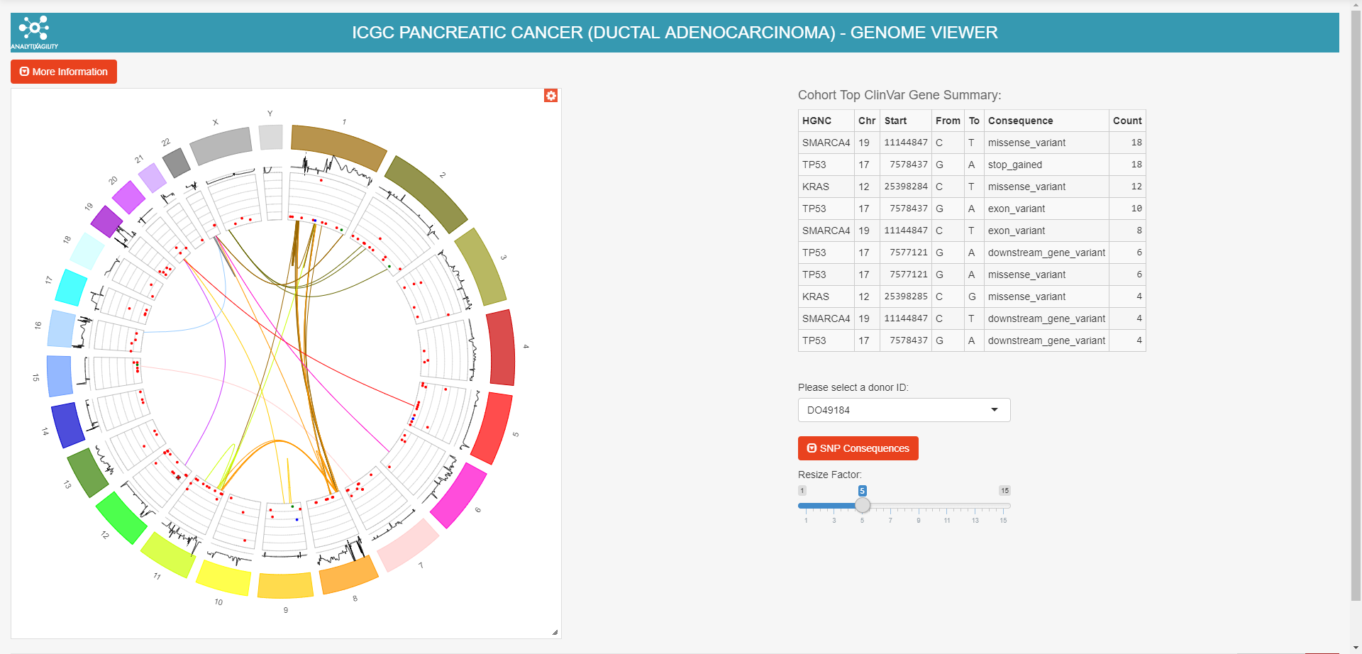
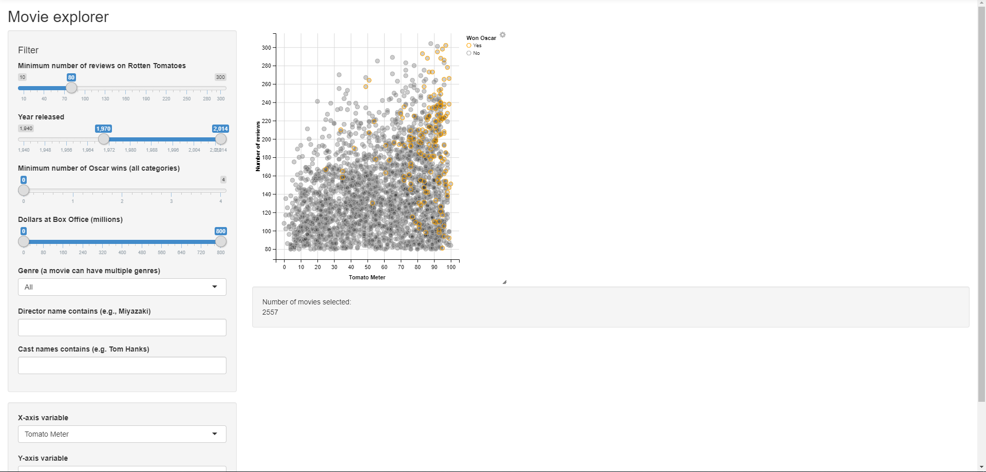
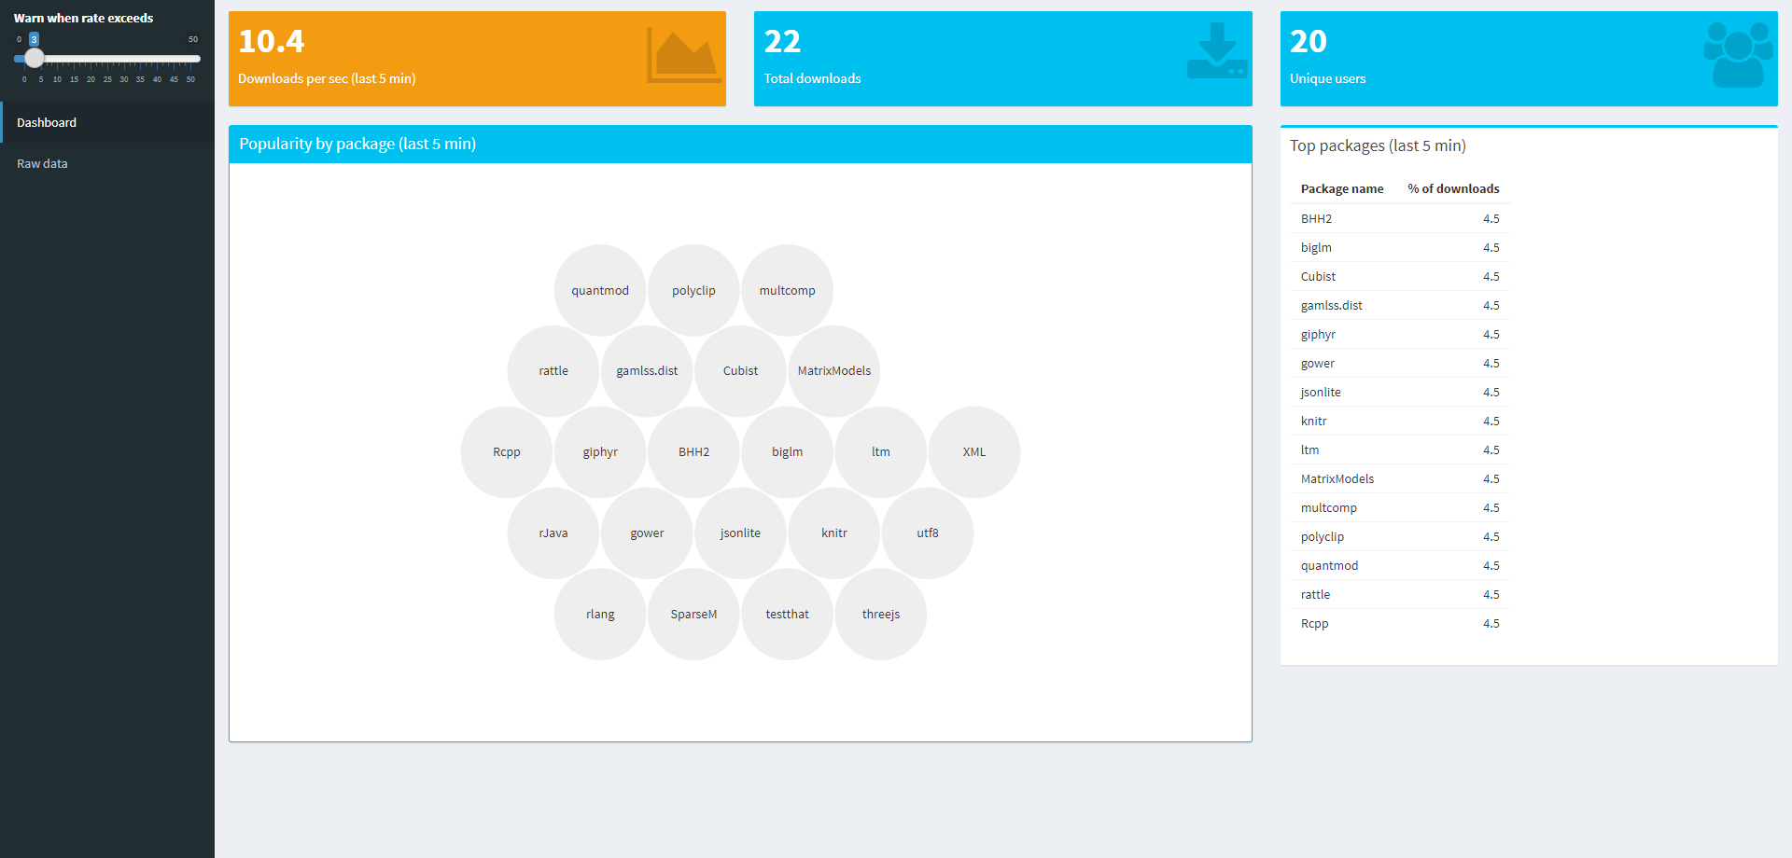
R Connect templates

Slide 8

Project Introduction
Pokemon spawn map location for Pokemon GO
Project is about spawn location of each monster
Seperate by
  City
  Pokemon
  Weather
Another options
  Date
  A period of days

Slide 9
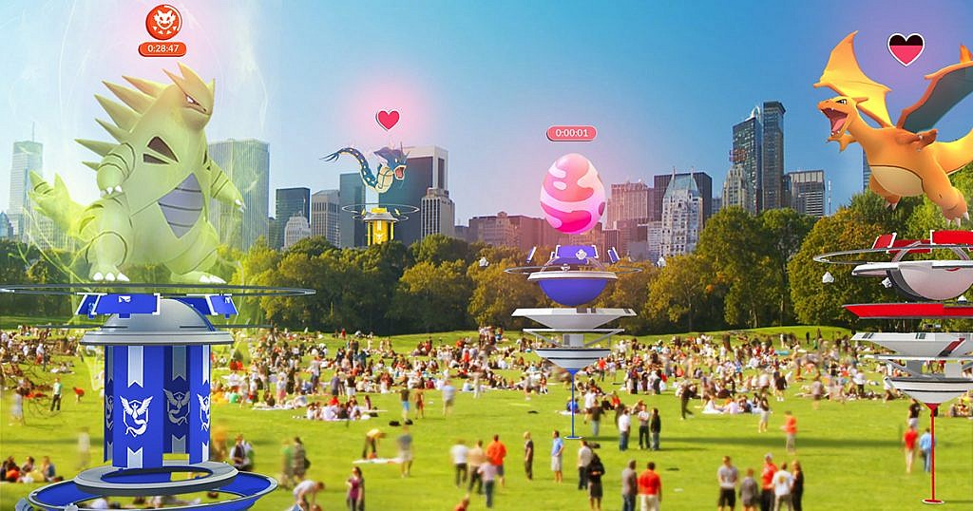
About Dataset
R Language does statistic computing, so we need to find and prepare dataset.
Dataset that we use in this project comes from kaggle website
Dataset consists of roughly 293,000 Pokemons having coordinates, time, weather, population density, distance to pokestops / gym etc. as features.
Reference: https://www.kaggle.com/semioniy/predictemall/home

Slide 10
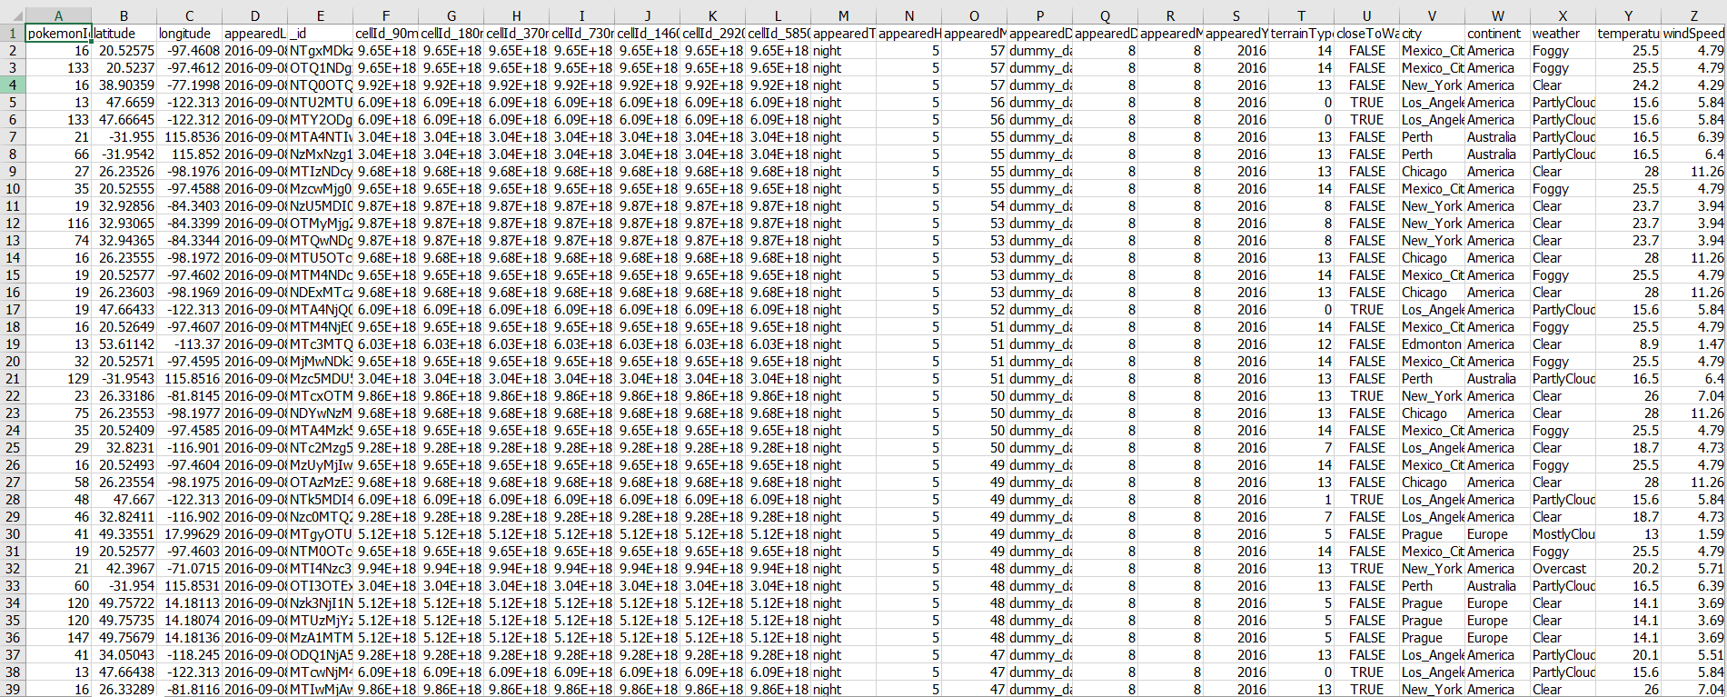
Dataset Preview

Slide 11
What do we Do?
Use latitude and longitude provided in dataset is used to mark the location on map.
Extended Library
  R shiny
  Leaflet
Seperate Pokemon dataset followed by user’s option

Slide 12
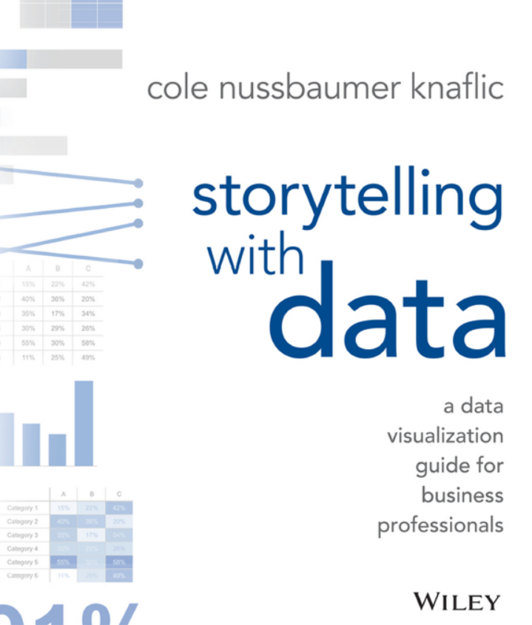
How we design the interfaces?
We design the interfaces based on the book name “Story telling with Data”
We use the concepts that we have learned in the book to produce the data visualization to make audience understand the content easily

Slide 13
How we design the interfaces?
Based on five points that will make the data tell a story better
Most of our user are playing Pokemon Go
Use sample text to make people easy to read
Use pokemon icons to reduce brain power
Make the player’s who play Pokemon GO see the result that they want to know
We provide the data visualization to make the data that is originally hard to read to be easy to understand

Slide 14
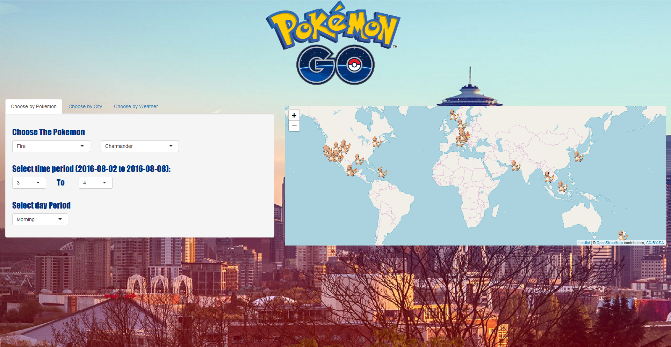
User interface

Slide 15
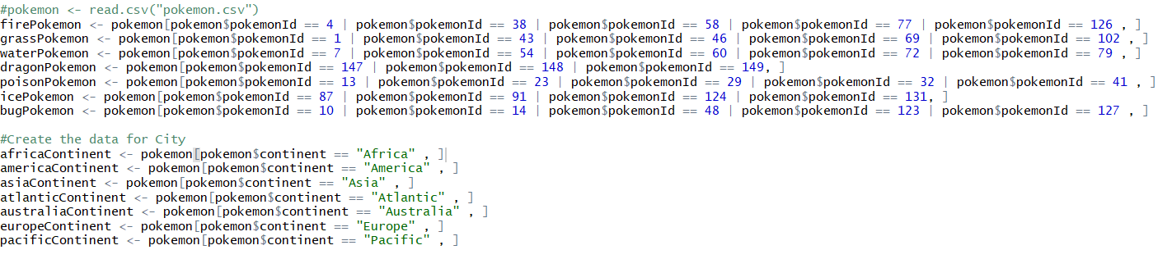
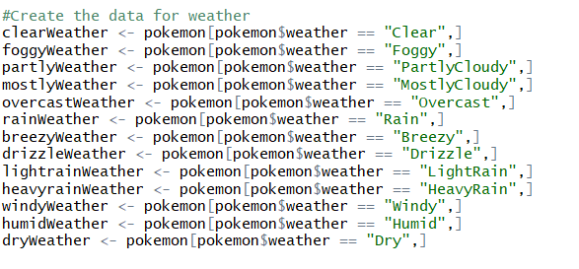
Data Preprocessing

Slide 16
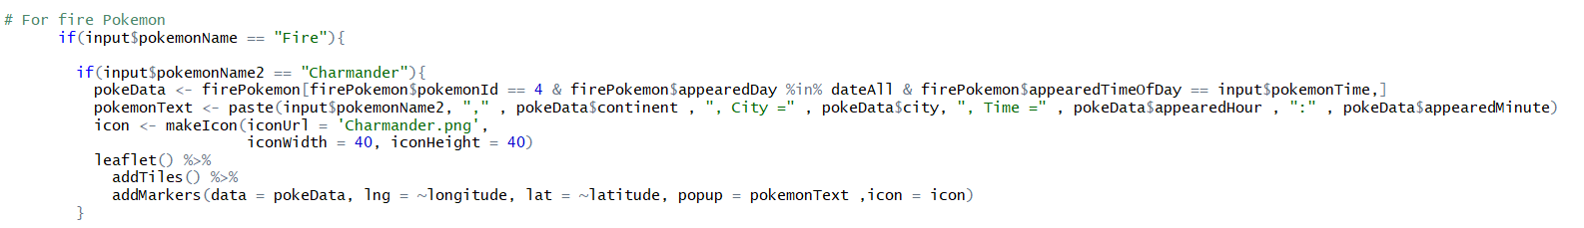
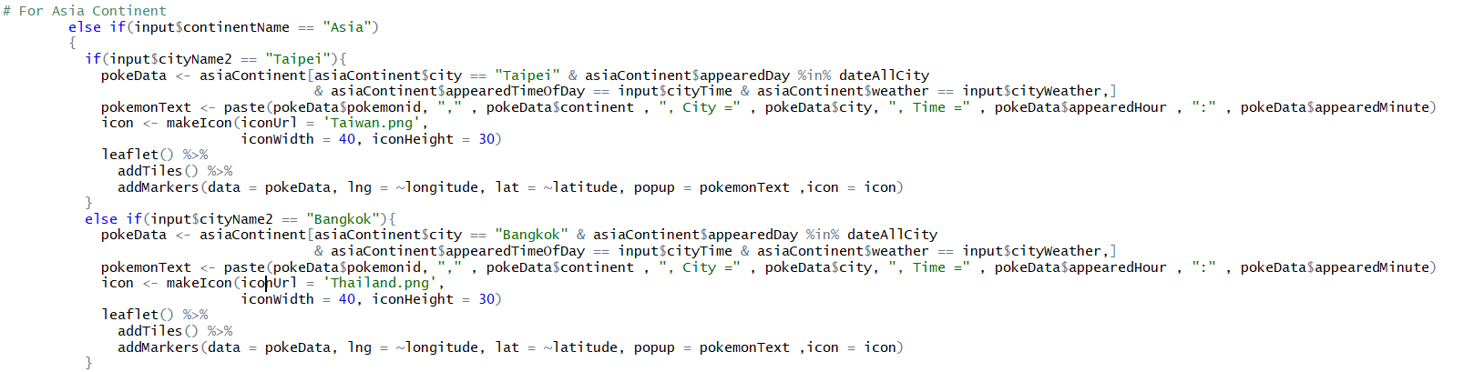
Data Preprocessing

Slide 17
Live Demo

Slide 18

Future Improvement
We will increase the number of Pokemons
We will extend Date and Time
We will add Pokestops
We will find more datasets to do the data visualization and make program more stable
We will learn to analyze dataset to gain
more knowledge (Data Mining) and
improve our program skill.

Slide 19
Summary
The thing that we learned from this summer
R Language
R Connect
R Shiny
Data Visualization
Taiwan culture

Slide 20




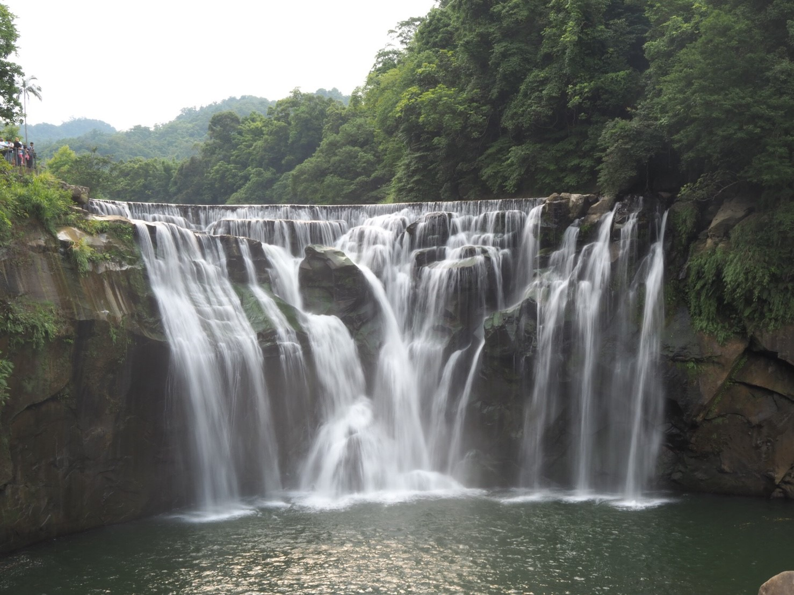

Taiwan culture

Slide 21
Thanks you for your attention :)

